Slide 1
Real Estate Investment
Top Zip Codes in United States – 5 Year Return on Investment
A Time-Series Data Science Project
Jim Petoskey
Flatiron School
Phase 4

Slide 2
Outline
Business Opportunity
Summary
Data
Methods
Results
Conclusions
Further Study

Slide 3
Business Opportunity
High rate of return likely over the next 5 years.
Models for top zip codes predict price within 3% of market value
All zip codes in the United States have been parsed for the best returns over the past 6 years, in addition to analyzing top mid-size cities and mountain towns, which have become more attractive since the covid pandemic.

Slide 4
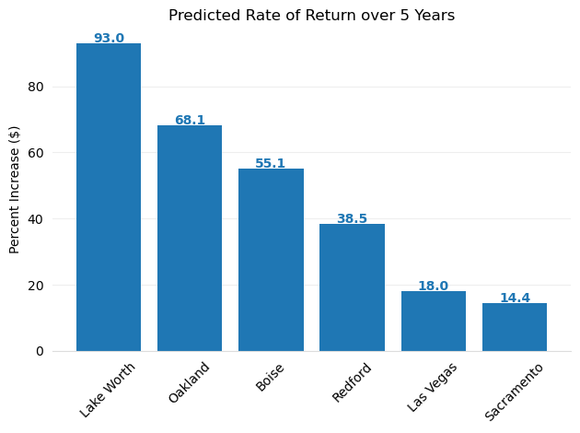
Summary
Top 15 zip codes by rate of return from April 2012 – April 2018 were modeled, in addition to 20 zip codes from 5 Mountain Towns and 5 Mid-Size Cities.
Boise is the only city added from Mountain Towns and Mid-Size cities due to high return and low risk.
Highly accurate modeling.
Each model in this visualization predicted median price within 3% of market value.
Except for Boise, which predicted price within 8% of market value.

Slide 5
Data
Represents 14,723 zip codes, including all 50 states in the US
Contains median price of homes in each zip code on a monthly basis from April 1996 to April 2018.
Some zip codes contain missing data – one of these zip codes was removed from the top 15 zip codes by rate of return from April 2012-2018.
Initially, stored in wide format, converted to long format with time-series index for modeling purposes.

Slide 6
Methods
SARIMA model used – currently best model for time series
Best parameters for model determined for each zip code individually.
RMSE ratio to median market value calculated to determine accuracy of models.
Models for each zip code can reliably be compared to each other to determine which zip code is being modeled more accurately.
Model Forecast predicts price of homes in 5 years.
Percent Market Value Increase and Confidence Interval calculated and plotted in visualizations for recommended zip codes.

Slide 7
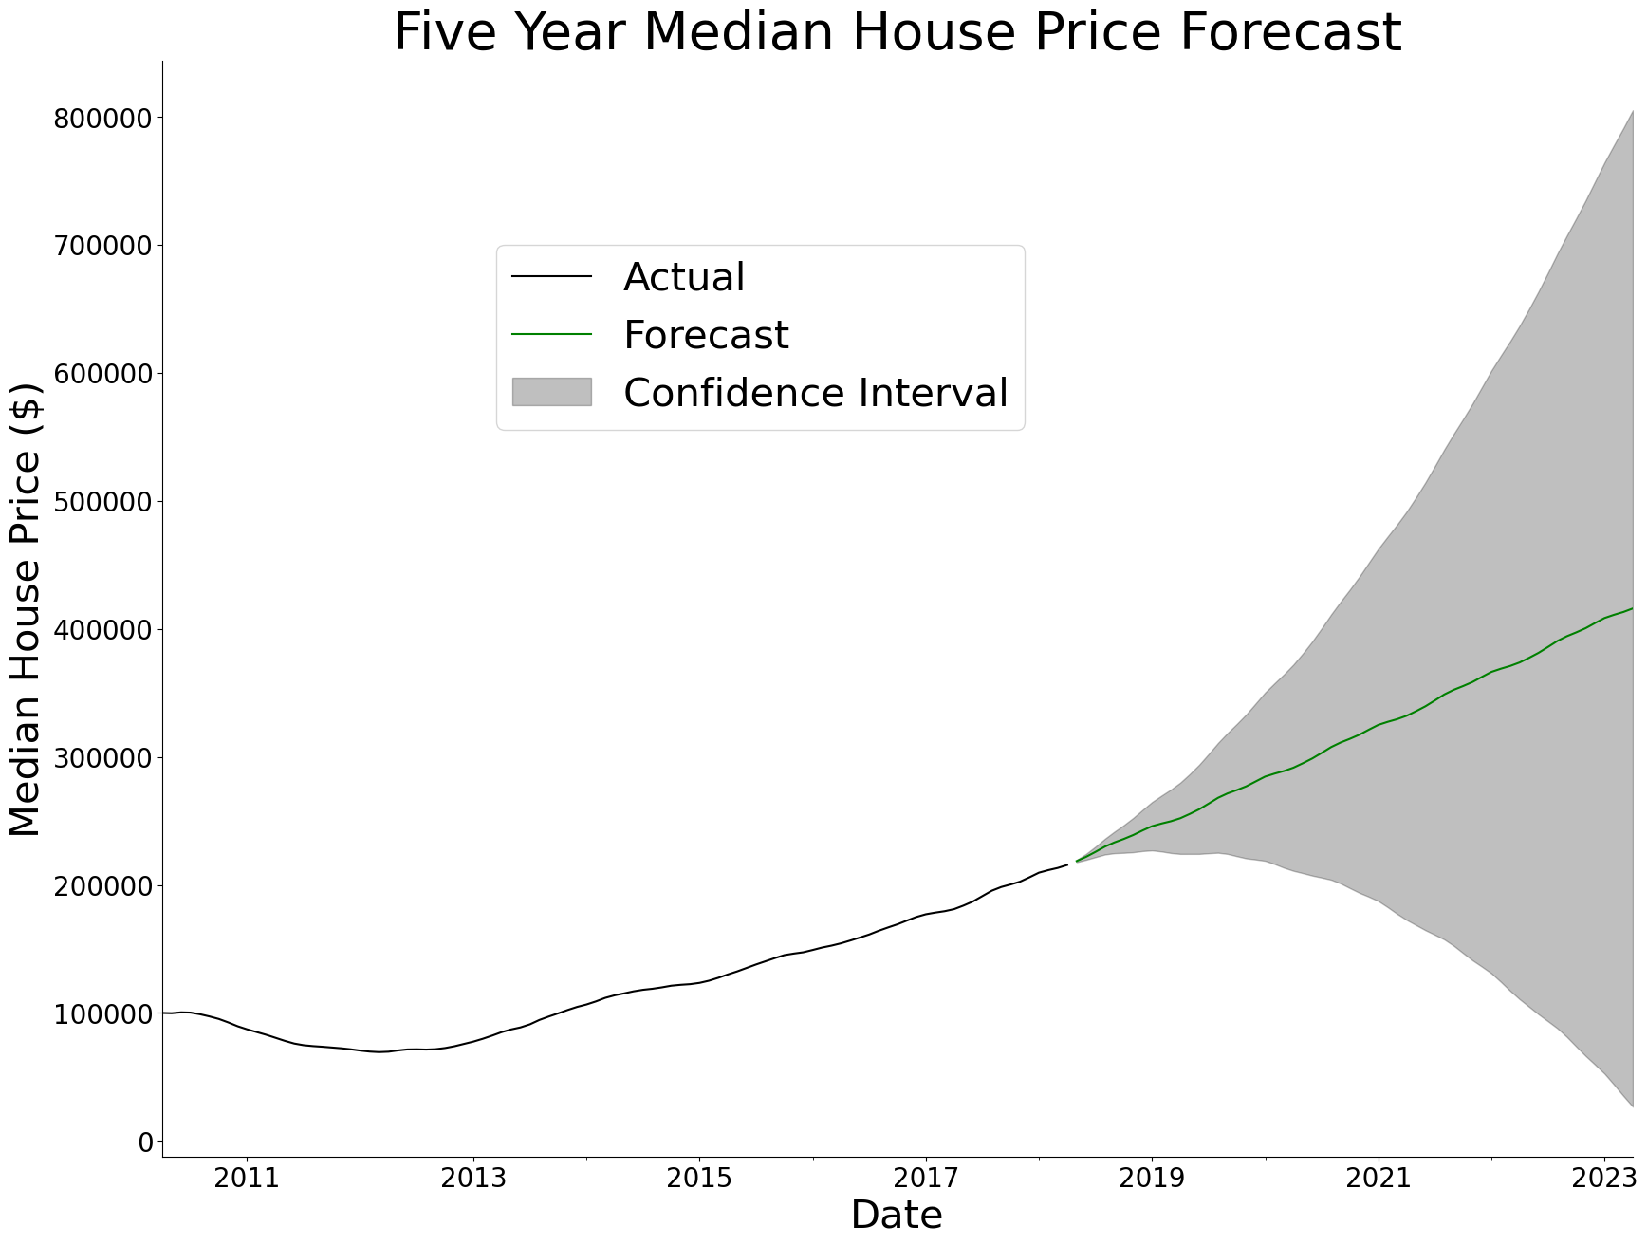
Results - Lake Worth, FL 33460
Highest predicted return of 93.0%
High risk with wide range and large negative potential for the confidence interval price at 5 years
High level of model accuracy:
Predictions within 1.3% of median value on average.

Slide 8
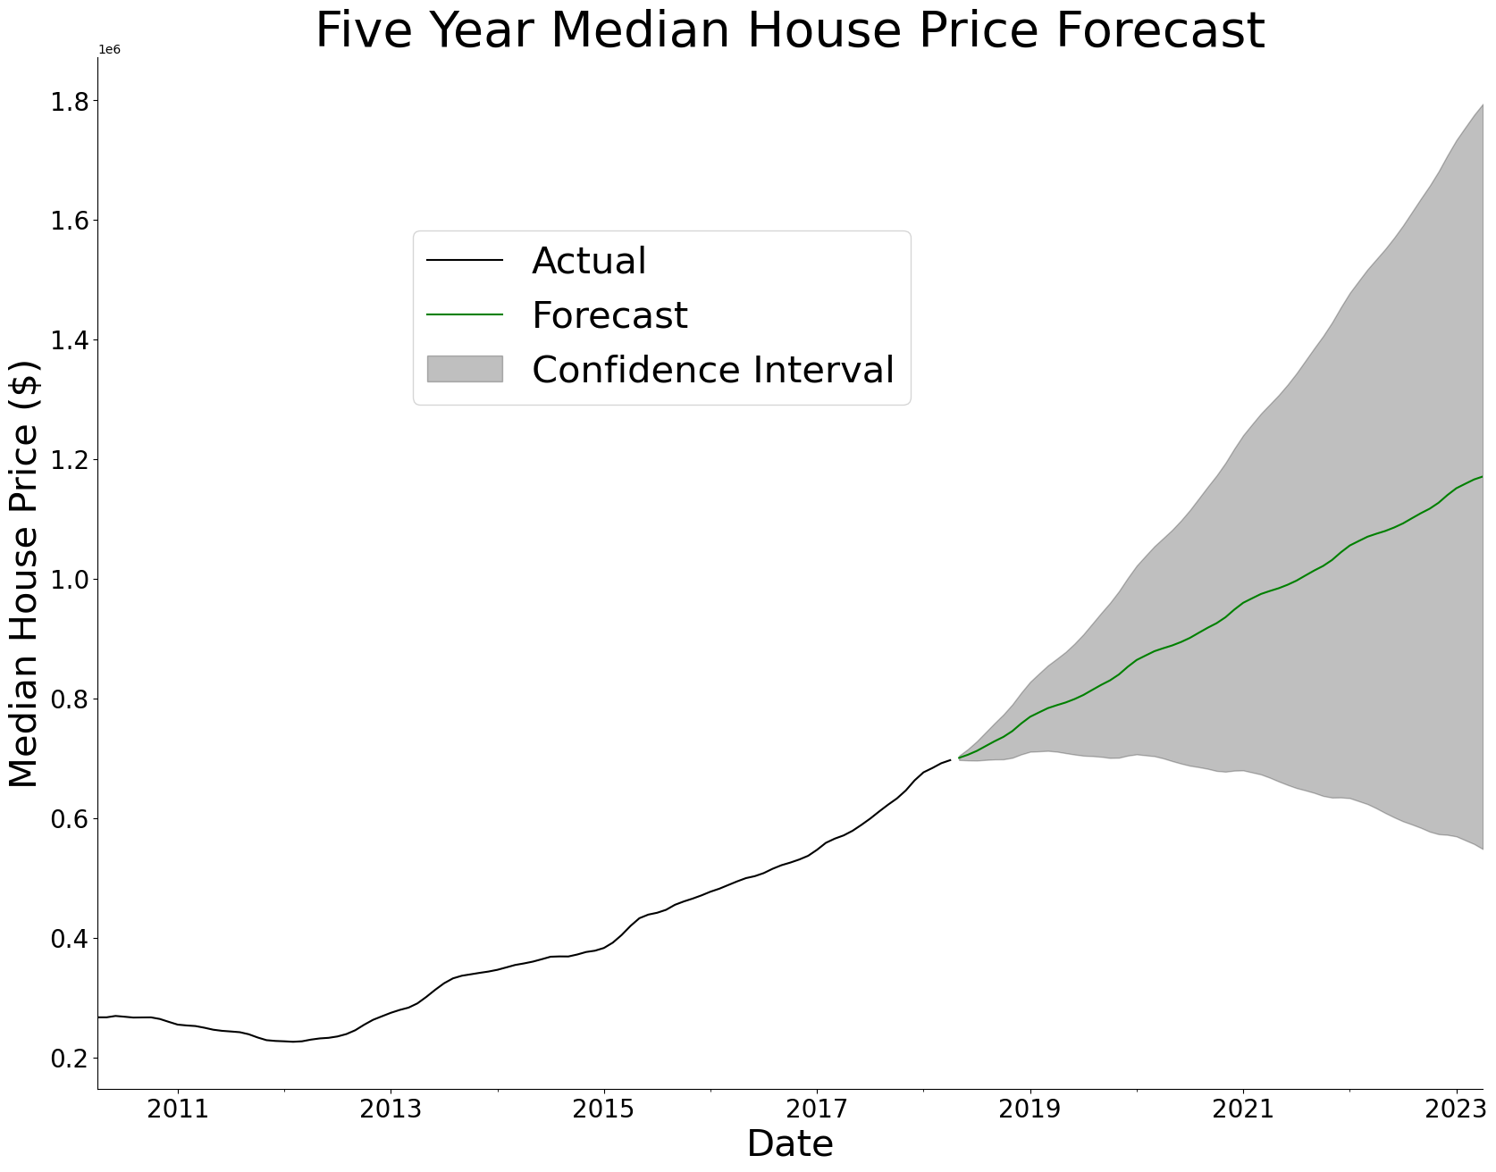
Results - Oakland, CA 94606
Has a predicted rate of return of 68.1% over the next 5 years (assuming we are in April of 2018 when this dataset was current)
Has the lowest margin of risk - with the lowest confidence interval value being substantially higher than the models for other zip codes.
High level of model accuracy:
Predictions within 3% of median value on average.

Slide 9
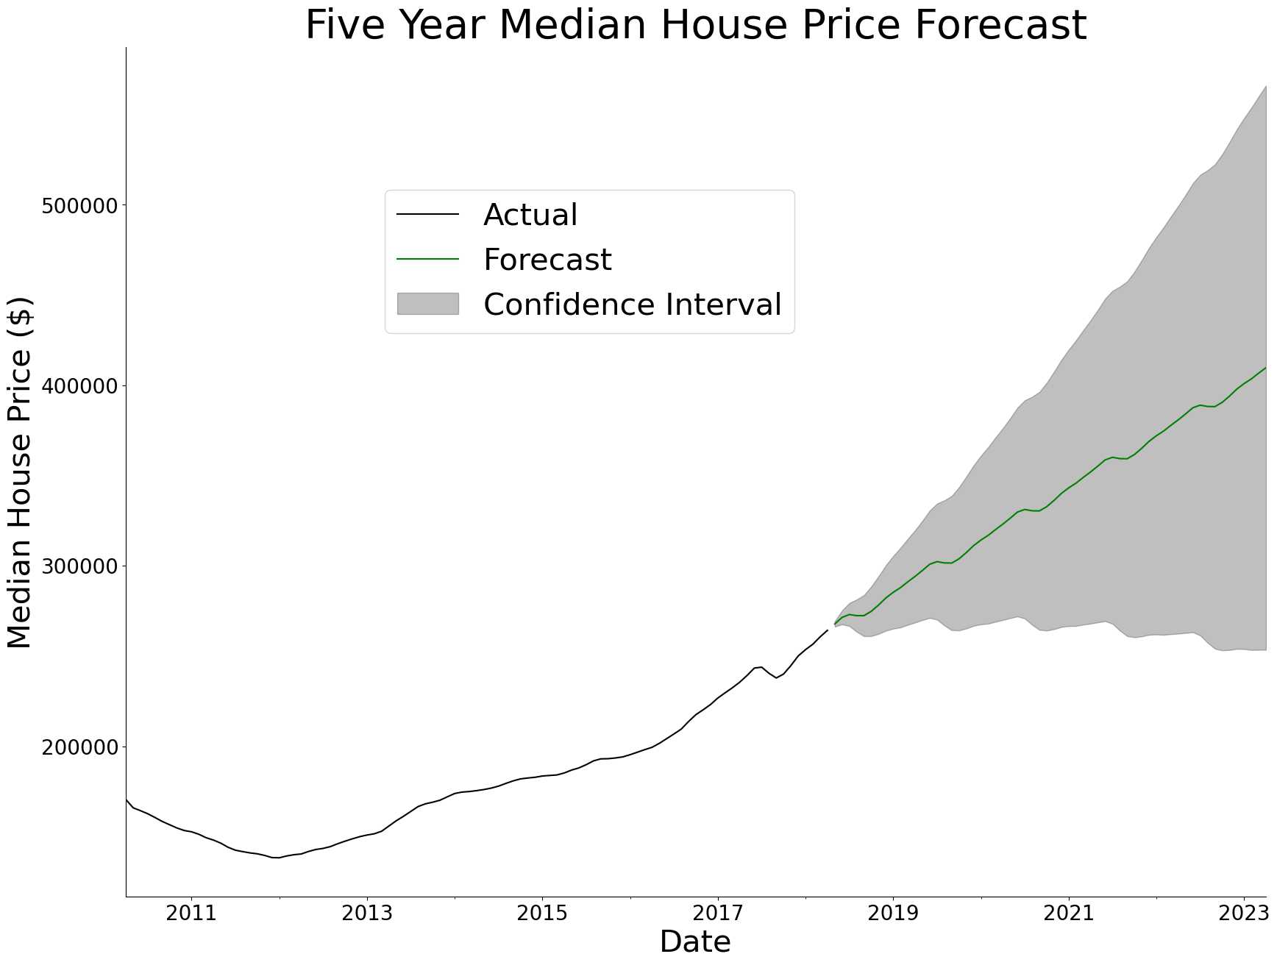
Results – Boise, ID 83703
High predicted return of 55.1%
Low risk, with lowest confidence interval value being substantially higher than the models for other zip codes.
Moderate level of model accuracy:
Predictions within 8% of median value on average.

Slide 10
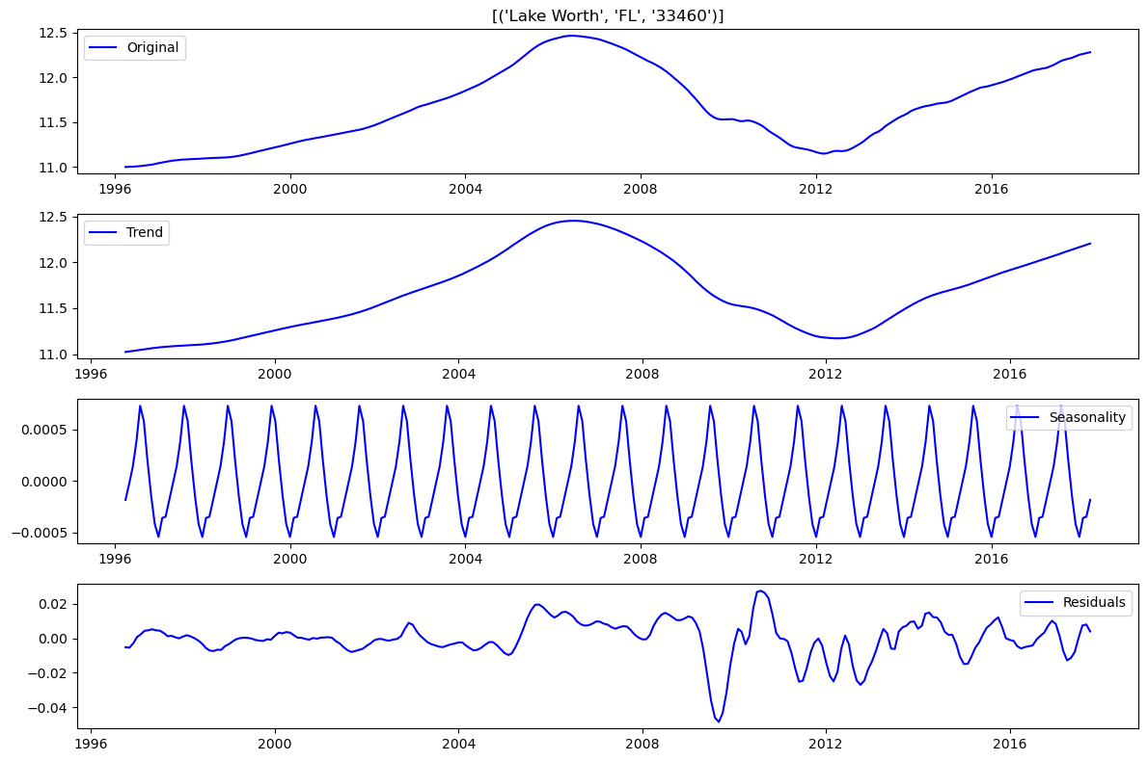
Results – Seasonal Pattern
Seasonal Pattern
Not visible in raw data, so important to note that seasonality is present in every zip code and prices are higher in the summer and lower in the winter.

Slide 11
Conclusions
Invest in all three recommended zip codes.
They offer a greater likelihood of strong returns when all are part of the investment portfolio.
Optimize for highest returns, higher risk:
Allocate greater percentage of investment to Lake Worth
Optimize for lower risk, still high returns:
Allocate greater percentage of investment to Boise and Oakland
Note that if units of investment are of concern:
Lake Worth and Boise have lower overall cost per house, so more houses will need to be purchased to obtain the same return

Slide 12
Further Study
Adding to the model
Need more recent data
Add external influences with more complex models, such as:
Average interest rates for mortgages
Overall employment, nationally or locally
Percent Increase or decrease in jobs in the county of that zip code
Ongoing testing
Need monitoring and testing of price changes in real-time
Increase frequency of median house sale measures, if possible. (i.e. weekly)
Additional zip codes
Ensure big cities, such as New York, Los Angeles, and Chicago are represented.

Slide 13
Q & A Time
Jim Petoskey – Data Scientist
Jim.Petoskey.146@gmail.com
Phone: (734) 649-3182
linkedin.com/in/jimpetoskey/

